Slide 1
DPIM Level 2 : Design

Slide 2
Why is Design so Difficult?
Analysis: Focuses on the application domain
Design: Focuses on the solution domain
  The solution domain is changing very rapidly
    Halftime knowledge in software engineering: About 3-5 years
    Cost of hardware rapidly sinking
  Design knowledge is a moving target
Design window: Time in which design decisions have to be made.

Slide 3
The Scope of System Design
Problem
Bridge the gap
  between a problem and an existing system in a manageable way
System
Design
How?
Use Divide & Conquer:
  1) Identify design goals
  2) Model the new system design as a set of subsystems
  3-8) Address the major design goals.
Existing System

Slide 4
System Design: Eight Issues
System Design
8. Boundary
Conditions
1. Identify Design Goals
Additional NFRs
Trade-offs
Initialization
Termination
Failure.
2. Subsystem Decomposition
7. Software
Control
Layers vs Partitions
Coherence & Coupling
Monolithic
Event-Driven
Conc. Processes
3. Identify Concurrency
Identification of
Parallelism
(Processes,
Threads)
4. Hardware/
Software Mapping
5. Persistent Data
Management
6. Global Resource
Handlung
Identification of Nodes
Special Purpose Systems
Buy vs Build
Network Connectivity
Storing Persistent Objects
Filesystem vs Database
Access Control
ACL vs Capabilities
Security
Notes:
1. Design goals
2. System decomposition
Breaking the system into subsystems, Layers and partitions, System information flow (topology)
3. Identification of concurrency
Threads of control
4. Hardware/software allocation
Estimate hardware requirements, Hardware/software trade-offs, Describe processor allocation, Physical connectivity (existing hardware)
5. Data management
Data structures implemented in memory or secondary storage
6. Global resource handling
Choose access control
7. Software control implementation
Procedure-based, event-based, concurrent systems
8. Boundary conditions
Describe behavior at initialization, termination and failure
9. Feasibility
Discuss design alternatives, Technological constraints that drive the design, What if the constraints change?

Slide 5
Overview
System Design I (This Lecture)
  0. Overview of System Design
  1. Design Goals
  2. Subsystem Decomposition, Software Architecture
System Design II (Next Lecture)
  3. Concurrency: Identification of parallelism
  4. Hardware/Software Mapping:
  Mapping subsystems to processors
  5. Persistent Data Management: Storage for entity objects
  6. Global Resource Handling & Access Control:
  Who can access what?)
  7. Software Control: Who is in control?
  8. Boundary Conditions: Administrative use cases.
Notes:
Rumbaugh distinguishes two kinds of design: System design and Object design. System design, the topic of this and the next lecture is concerned with the overall aspects of the system. What are the goals it tries to achieve. The main goals are: Low cost, good response time, high reliability. Types (Often listed under Global requirements in Problem Statement). Trade-off priorities
System design is also concerned about the overall structure of the system. How is it broken into pieces? How do these pieces fit together? Must they know about each other? The best system design is one where the interaction between the subsystems is minimal.
Concurrency is another important design issue. The more concurrency we can identify in a system, the better it can perform.
Mapping the subsystem to processors is the moment of truth, and the hardest. While decomposition and concurrency identification are still independent of technology, subsystem allocation is not. Shall we map them to hardware or can we get by with software (Example: Floating point package).
The management of data is also a design issue. The FRIEN database group is an example: Most of its problems are design specific.
Access methods specify the security of the design. Can a random user or a program gone hay-wire create havoc to the rest of the system?
Control is another important design issue. Who is in control? A main program or a set of harmoniously cooperating processes?
Boundary conditions specify the non-steady state behavior of the system. Usually the designer worries about the steady state (average number of transactions/sec). However, initialization and termination behavior, in particular failure conditions are important design issues. How does the system behave when an error occurs? Does it simply type "Illegal address at PC 0. Abort!" (Famous last words on a screen cockpit filmed by a video camera before the plane, an F-15 fighter, crashed).
For the FRIEND system, database design issues are very important. We will discuss several design goals that are very important for the design of distributed databases

Slide 6
Analysis Sources: Requirements and System Model
Functional Model
8. Boundary
Conditions
1. Design Goals
Nonfunctional
Requirements
Definition
Trade-offs
Initialization
Termination
Failure
Functional Model
2. System Decomposition
Dynamic
Model
7. Software
Control
Layers vs Partitions
Coherence/Coupling
Monolithic
Event-Driven
Conc. Processes
Dynamic
Model
3. Concurrency
Object Model
Identification of
Threads
4. Hardware/
Software Mapping
5. Data
Management
6. Global Resource
Handlung
Special Purpose Systems
Buy vs Build
Allocation of Resources
Connectivity
Persistent Objects
Filesystem vs Database
Access Control List
vs Capabilities
Security
Notes:
1. Design goals
2. System decomposition
Breaking the system into subsystems, Layers and partitions, System information flow (topology)
3. Identification of concurrency
Threads of control
4. Hardware/software allocation
Estimate hardware requirements, Hardware/software trade-offs, Describe processor allocation, Physical connectivity (existing hardware)
5. Data management
Data structures implemented in memory or secondary storage
6. Global resource handling
Choose access control
7. Software control implementation
Procedure-based, event-based, concurrent systems
8. Boundary conditions
Describe behavior at initialization, termination and failure
9. Feasibility
Discuss design alternatives, Technological constraints that drive the design, What if the constraints change?

Slide 7
How the Analysis Models influence System Design
Nonfunctional Requirements
  => Definition of Design Goals
Functional model
  => Subsystem Decomposition
Object model
  => Hardware/Software Mapping, Persistent Data Management
Dynamic model
  => Identification of Concurrency, Global Resource Handling, Software Control
Finally: Hardware/Software Mapping
  => Boundary conditions
Notes:
In Requirements analysis we have beautifully built 3 descriptions of the problem, the models.
Where do the models go in system design? The above list of system design issues looks a little bit random.
But there is a reason behind it:
Nonfunctional Requirements
=> Definition of Design Goals
Functional model
=> Subsystem Decomposition (Subsystems based on functional requirements, coherence & coupling)
Object model
=> Hardware/software Mapping and Data Management (Persistent objects)
Dynamic model
=> Identification of Concurrency, Global Resource Handling, Software Control
Finally: From the Subsystem Decomposition
=> Boundary conditions

Slide 8
From Analysis to System Design
Nonfunctional
Requirements
Functional Model
8. Boundary
Conditions
1. Design Goals
Definition
Trade-offs
Initialization
Termination
Failure
Functional Model
2. System Decomposition
Dynamic
Model
Layers vs Partitions
Coherence/Coupling
7. Software
Control
Dynamic
Model
Object Model
Monolithic
Event-Driven
Conc. Processes
4. Hardware/
Software Mapping
5. Data
Management
6. Global Resource
Handlung
3. Concurrency
Identification of
Threads
Special Purpose Systems
Buy vs Build
Allocation of Resources
Connectivity
Persistent Objects
Filesystem vs Database
Access Control List
vs Capabilities
Security
Notes:
1. Design goals
2. System decomposition
Breaking the system into subsystems, Layers and partitions, System information flow (topology)
3. Identification of concurrency
Threads of control
4. Hardware/software allocation
Estimate hardware requirements, Hardware/software trade-offs, Describe processor allocation, Physical connectivity (existing hardware)
5. Data management
Data structures implemented in memory or secondary storage
6. Global resource handling
Choose access control
7. Software control implementation
Procedure-based, event-based, concurrent systems
8. Boundary conditions
Describe behavior at initialization, termination and failure
9. Feasibility
Discuss design alternatives, Technological constraints that drive the design, What if the constraints change?

Slide 9
Example of Design Goals
Reliability
Modifiability
Maintainability
Understandability
Adaptability
Reusability
Efficiency
Portability
Traceability of requirements
Fault tolerance
Backward-compatibility
Cost-effectiveness
Robustness
High-performance
Good documentation
Well-defined interfaces
User-friendliness
Reuse of components
Rapid development
Minimum number of errors
Readability
Ease of learning
Ease of remembering
Ease of use
Increased productivity
Low-cost
Flexibility

Slide 10
Stakeholders have different Design Goals
Low cost
Increased productivity
Backward compatibility
Traceability of requirements
Rapid development
Flexibility
Functionality
User-friendliness
Usability
Ease of learning
Fault tolerant
Robustness
Runtime
Efficiency
Reliability
Portability
Good documentation
Client
(Customer)
End
User
Minimum # of errors
Modifiability, Readability
Reusability, Adaptability
Well-defined interfaces
Developer/
Maintainer
Notes:
Nielson
Usability Engineering
Rubin
Task Analysis

Slide 11
Typical Design Trade-offs
Functionality v. Usability
Cost v. Robustness
Efficiency v. Portability
Rapid development v. Functionality
Cost v. Reusability
Backward Compatibility v. Readability
Notes:
Example: Functionality vs usability. Is a system with 100 functions usable? How about a large scale menu?
Low Cost vs Robustness: A low cost system does not check for errors when the user is entering wrong data
(ebay Entry 5.00 vs 5,00). Let‘s say you bid for 5, 00 Euro
In Germany 5,00 is 5 Euros, if the entry routine expects a „.“, then the „,“ might be overlooked,
and you have bidden. for 500 Dollars!
Efficiency vs Portability: Can you build a portable real-time game? How do you get high framerates. Special graphics routines that access the display buffer! That is usually not portable. If you write portable graphics code, say with the OpenGL, then you sometimes might not get the response times you are looking for. All special graphics code is still hand-tailored for a specific machine or graphics processor.
Rapid development vs. functionality: Let’s say your development time is 5 weeks, you have 5 programmers, your design window is 2 weeks, after design 3 programmers are leaving your company, and your delivery deadline cannot be moved. You are going to reduce the functionality. Not all the use cases in your model can be implemented nor delivered.
Cost vs. Reusability: This is an interesting trade-off, whose validity is changing right now. In the past, if you tried to make your design reusable you had to add extra effort. Recode your data structures (move from array of int to array of Generic). Moving from a 1-1 association to a many-many association involved more coding and more testing. Nowadays, with design patterns, this trade-off is changing a little bit. You can get reusability pretty cheap if you use design patterns!
Backward Compatibility vs Readability.
The same applies to this trade-off. In the past you would guarantee backward compatibility by introducing special switches.
#Ifdef OldSystem then WriteToPaperTapeWriter
#Ifdef Newsystems then WritetoCD-R
Nowadays, again with the use of design patterns, for example, the bridge pattern, you can keep a system backward compatibile and still keep it readable!

Slide 12
Subsystem Decomposition
Subsystem
  Collection of classes, associations, operations, events and constraints that are closely interrelated with each other
  The objects and classes from the object model are the “seeds” for the subsystems
  In UML subsystems are modeled as packages
Service
  A set of named operations that share a common purpose
  The origin (“seed”) for services are the use cases from the functional model
Services are defined during system design.
Notes:
Relation of subsystems to each other is similar to object model
System topology is similar functional model!
A service is a group of operations provided by the subsystem
Services are defined during system design and refined as subsystem interfaces during object design.

Slide 13
Subsystem Interfaces vs API
Subsystem interface: Set of fully typed UML operations
  Specifies the interaction and information flow from and to subsystem boundaries, but not inside the subsystem
  Refinement of service, should be well-defined and small
  Subsystem interfaces are defined during object design
Application programmer’s interface (API)
  The API is the specification of the subsystem interface in a specific programming language
  APIs are defined during implementation
The terms subsystem interface and API are often confused with each other
  The term API should not be used during system design and object design, but only during implementation.

Slide 14
Example: Notification subsystem
Service provided by Notification Subsystem
    LookupChannel()
    SubscribeToChannel()
    SendNotice()
    UnscubscribeFromChannel()
Subsystem Interface of Notification Subsystem
  Set of fully typed UML operations
API of Notification Subsystem
  Implementation in Java

Slide 15
Subsystem Interface Object
Good design: The subsystem interface object describes all the services of the subsystem interface
Subsystem Interface Object
  The set of public operations provided by a subsystem
  Subsystem Interface Objects can be realized with the Façade pattern (=> lecture on design patterns).
Notes:
We will use the Facade design pattern to model the subsystem interface object

Slide 16
Properties of Subsystems: Layers and Partitions
A layer is a subsystem that provides a service to another subsystem with the following restrictions:
  A layer only depends on services from lower layers
  A layer has no knowledge of higher layers
A layer can be divided horizontally into several independent subsystems called partitions
  Partitions provide services to other partitions on the same layer
  Partitions are also called “weakly coupled” subsystems.
Notes:
A large system should be decomposed into subsystems using both, layers and partitions
Layering and partitioning are techniques to achieve low coupling!!!
In an object-oriented design, each subsystem makes its layer a subclass of the generic layer class provided by the UI subsystem.
In JEWEL, each individual subsystem provides its own zoom and refresh methods.
Ideally the refresh method will be called for every draw operation. The UI subsystem is responsible for knowing when to call for a refresh (but the UI group will not have to implement it itself: it is a callback method implemented by the visualization and GIS group). All the interfaces with UI (such as how UI will provide the other groups with selection information) should be well documented and agreed on by all groups.

Slide 17
Relationships between Subsystems
Two major types of Layer relationships
  Layer A “depends on” Layer B (compile time dependency)
    Example: Build dependencies
    Layer A “calls” Layer B (runtime dependency)
    Example: A web browser calls a web server
    Can the client and server layers run on the same machine?
      Yes, they are layers, not processor nodes
      Mapping of layers to processors is decided during the Software/hardware mapping!
Partition relationship
  The subsystems have mutual knowledge about each other
    A calls services in B; B calls services in A (Peer-to-Peer)
UML convention:
  Runtime dependencies are associations with dashed lines
  Compile time dependencies are associations with solid lines.
Notes:
Example: Peer-to-Peer systems

Slide 18
Example of a Subsystem Decomposition
Partition
relationship
Layer
Relationship
„depends on“
Layer 1
A:Subsystem
Layer 2
B:Subsystem
C:Subsystem
D:Subsystem
Layer 3
E:Subsystem
F:Subsystem
G:Subsystem
Layer
Relationship
„calls“
Notes:
Subsystem Decomposition Heuristics
- No more than 7+/-2 subsystems
More subsystems increase coherence but also complexity (more services)
- No more than 4+/-2 layers
Good design: Try to find 3 layers!!!! In many cases this is possible. 3-tier-architectures are an example

Slide 19
Coupling and Coherence of Subsystems
Goal: Reduce system complexity while allowing change
Coherence measures dependency among classes
  High coherence: The classes in the subsystem perform similar tasks and are related to each other via many associations
  Low coherence: Lots of miscellaneous and auxiliary classes, almost no associations
Coupling measures dependency among subsystems
  High coupling: Changes to one subsystem will have high impact on the other subsystem
  Low coupling: A change in one subsystem does not affect any other subsystem.
Notes:
The goal is a reduction of complexity while change occurs.
A good subsystem decomposition has maximum coherence and minimum coupling:
How can we achieve high coherence?
How can we achieve low coupling?
Coherence measures dependency among classes
High coherence: The classes in the subsystem perform similar tasks and are related to each other via associations
Low coherence: Lots of miscellaneous and auxiliary classes, no associations
Coupling measures dependency among subsystems
High coupling: Changes to one subsystem will have high impact on the other subsystem (model change, massive recompilation,…)
Low coupling: A change in one subsystem does not affect any other subsystem

Slide 20
Coupling and Coherence of Subsystems
Good Design
Goal: Reduce system complexity while allowing change
Coherence measures dependency among classes
  High coherence: The classes in the subsystem perform similar tasks and are related to each other via associations
  Low coherence: Lots of miscellaneous and auxiliary classes, no associations
Coupling measures dependency among subsystems
  High coupling: Changes to one subsystem will have high impact on the other subsystem
  Low coupling: A change in one subsystem does not affect any other subsystem
Notes:
The goal is a reduction of complexity while change occurs.
A good subsystem decomposition has maximum coherence and minimum coupling:
How can we achieve high coherence?
How can we achieve low coupling?
Coherence measures dependency among classes
High coherence: The classes in the subsystem perform similar tasks and are related to each other via associations
Low coherence: Lots of miscellaneous and auxiliary classes, no associations
Coupling measures dependency among subsystems
High coupling: Changes to one subsystem will have high impact on the other subsystem (model change, massive recompilation,…)
Low coupling: A change in one subsystem does not affect any other subsystem

Slide 21
How to achieve high Coherence
High coherence can be achieved if most of the interaction is within subsystems, rather than across subsystem boundaries
Questions to ask:
  Does one subsystem always call another one for a specific service?
    Yes: Consider moving them together into the same subystem.
  Which of the subsystems call each other for services?
    Can this be avoided by restructuring the subsystems or changing the subsystem interface?
  Can the subsystems even be hierarchically ordered (in layers)?
Notes:
What kind of model is good for describing layers and partitions? UML Class diagrams!

Slide 22
How to achieve Low Coupling
Low coupling can be achieved if a calling class does not need to know anything about the internals of the called class (Principle of information hiding, Parnas)
Notes:
What kind of model is good for describing layers and partitions? UML Class diagrams!

Slide 23
Architectural Style vs Architecture
Subsystem decomposition: Identification of subsystems, services, and their association to each other (hierarchical, peer-to-peer, etc)
Architectural Style: A pattern for a subsystem decomposition
Software Architecture: Instance of an architectural style.
Notes:
Specification of the system decomposition is critical
An architectural style is a pattern or template for subsystem decomposition

Slide 24
Examples of Architectural Styles
  Client/Server
  Peer-To-Peer
  Repository
  Model/View/Controller
  Three-tier, Four-tier Architecture
  Service-Oriented Architecture (SOA)
  Pipes and Filters
Notes:
Styles are listed in Chapter 6, p. 237
We will talk about Client-Server, Peer-To-Peer, Repository and MVC,
Only in the book: Three-tier, Four-tier , Pipes and Filters

Slide 25
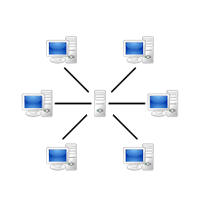
Client/Server Architectural Style
One or many servers provide services to instances of subsystems, called clients
Each client calls on the server, which performs
some service and returns the result
  The clients know the interface of the server
  The server does not need to know the interface of the client
The response in general is immediate
End users interact only with the client.
Server
Client
*
*
requester
provider
+service1()
+service2()
+serviceN()

Slide 26
Client/Server Architectures
Often used in the design of database systems
  Front-end: User application (client)
  Back end: Database access and manipulation (server)
Functions performed by client:
  Input from the user (Customized user interface)
  Front-end processing of input data
Functions performed by the database server:
  Centralized data management
  Data integrity and database consistency
  Database security
Notes:
Often used in the design of database systems
Front-end: User application (client)
Back end: Database access and manipulation (server)
Functions performed by client:
Customized user interface, Front-end processing of data
Initiation of server remote procedure calls, Access to database server across the network
Functions performed by the database server:
Centralized data management, Data integrity and database consistency
Database security, Concurrent operations (multiple user access)
Centralized processing (for example archiving)

Slide 27
Design Goals for Client/Server Architectures
Service Portability
Server runs on many operating systems and many networking environments
Location-
Transparency
Server might itself be distributed, but provides a single "logical" service to the user
High Performance
Client optimized for interactive display-intensive tasks; Server optimized for CPU-intensive operations
Scalability
Server can handle large # of clients
Flexibility
User interface of client supports a variety of end devices (PDA, Handy, laptop, wearable computer)
A measure of success with which the
observed behavior of a system confirms to the
specification of its behavior (Chapter 11: Testing)
Reliability
Server should be able to survive client and communication problems.
Notes:
The server might itself be distributed (why?),
Service Portability
Server should run on a variety of operating systems and work in a variety of networking environments
Location-Transparency
The server might itself be distributed, but should provide a single "logical" service to the user
Performance
Client should be optimized for interactive display-intensive tasks
Server should provide CPU-intensive operations
Scalability
Server should have spare capacity to handle large number of clients
Flexibility
The system should be usable for a variety of user interfaces and end devices (eg. PDA, Handy, laptop, wearable computer)
Reliability
System should survive individual client and communication link problems

Slide 28

Problems with Client/Server Architectures
Client/Server systems do not provide peer-to-peer communication
Peer-to-peer communication is often needed
Example:
  Database must process queries from application and should be able to send notifications to the application when data have changed
application1:DBUser
1. updateData
database:DBMS
application2:DBUser
2. changeNotification

Slide 29
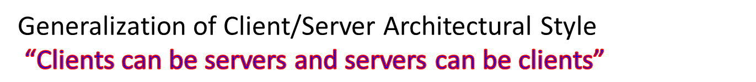
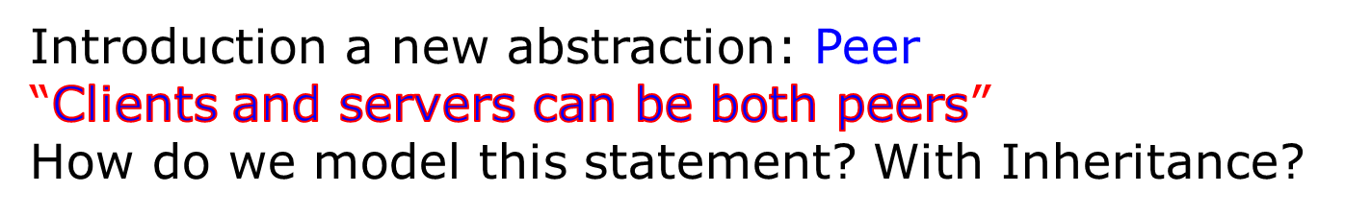
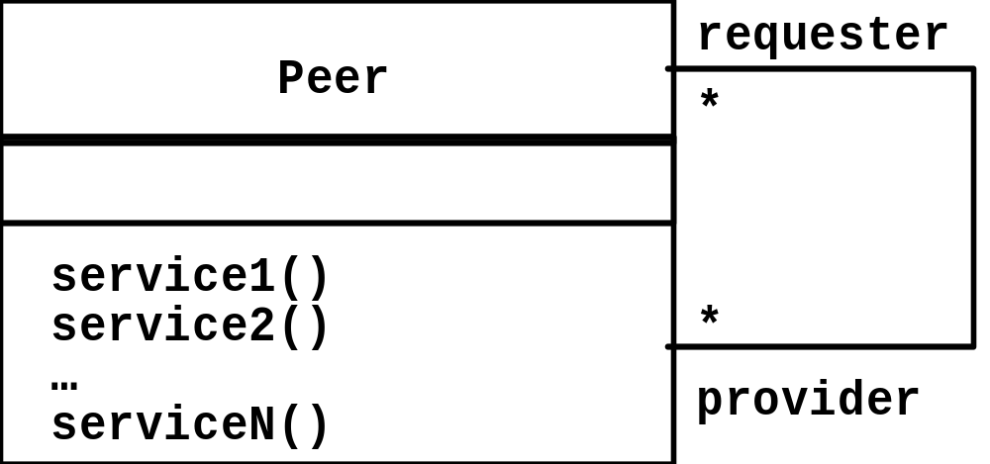
Peer-to-Peer Architectural Style
Proposal 1: “A peer can be either a client or a server”
Proposal 2: “A peer can be a client as well as a server”.
Notes:
More difficult because of possibility of deadlocks
“A Peer is either a Client or a Server”What is the corresponding UML model?
Make a hint that leads to the answer, that Peer is a superclass for client and server! Use the phrase “either or” and refer to Abbott’s technique!

Slide 30
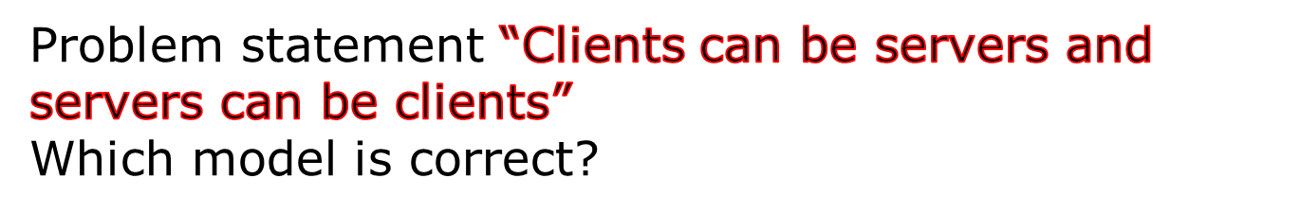
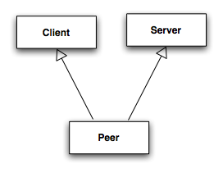
Relationship Client/Server & Peer-to-Peer
Model 1: “A peer can be either a client or a server”
Model 2: “A peer can be a client as well as a server”
?
Model 1
✔
Model 2
Client
Server
Notes:
More difficult because of possibility of deadlocks
“A Peer is either a Client or a Server”What is the corresponding UML model?
Make a hint that leads to the answer, that Peer is a superclass for client and server! Use the phrase “either or” and refer to Abbott’s technique!

Slide 31
Example: Peer-to-Peer Architectural Style
ISO’s OSI Reference Model
  ISO = International Standard Organization
  OSI = Open System Interconnection
Reference model which defines 7 layers and communication protocols between the layers
Application
Presentation
Level of abstraction
Session
Transport
Network
DataLink
Physical

Slide 32
OSI Model Layers and Services
The Application layer is the system you are building (unless you build a protocol stack)
  The application layer is usually layered itself
The Presentation layer performs data transformation services, such as byte swapping and encryption
The Session layer is responsible for initializing a connection, including authentication
Application
Presentation
!
Session
Transport
Network
DataLink
Physical
Notes:
Layers 1 to 6 are often called the protocol stack.

Slide 33
OSI Model Layers and their Services
The Transport layer is responsible for reliably transmitting messages
  Used by Unix programmers who transmit messages over TCP/IP sockets
The Network layer ensures transmission and routing
  Services: Transmit and route data within the network
The Datalink layer models frames
  Services: Transmit frames without error
The Physical layer represents the hardware interface to the network
  Services: sendBit() and receiveBit()
Application
Presentation
Session
Transport
Network
DataLink
Physical
Notes:
The Transport layer is responsible for reliably transmitting messages
This is the service seen by Unix programmers when want to transmit messages over TCP/IP sockets
The Network layer ensures data transmission
It provides the service to transmit and route date within the network
The Datalink layer models frames
It provides the service to send and receive frames without error
The Physical layer represents the hardware interface to the network.
It provides the service consisting of the operations send() and receive bits over a channel

Slide 34
The Application Layer Provides the Abstractions of the “New System”
RMI
Application
Application
Presentation
Presentation
Session
Session
Bidirectional associa- tions for each layer
Transport
Transport
Network
Network
Data Link
Data Link
Physical
Physical
Processor 1
Processor 2

Slide 35
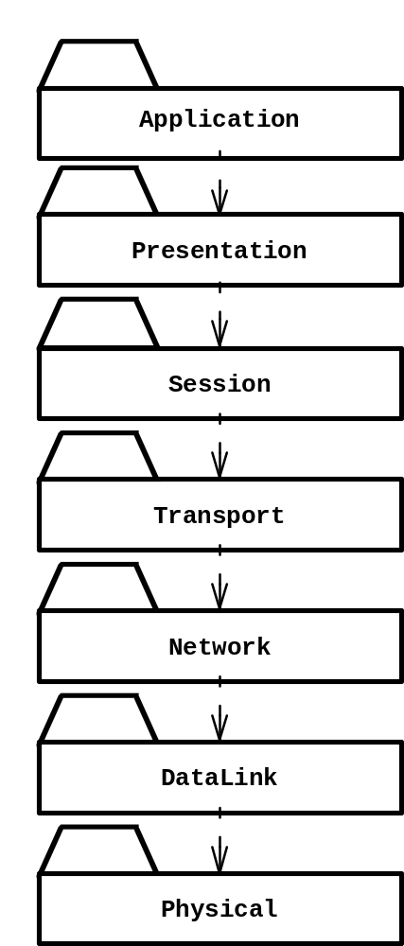
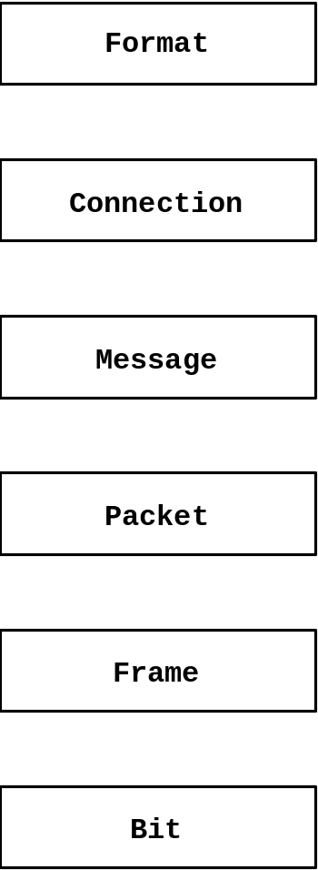
An Object-Oriented View of the OSI Model
The OSI Model is a closed software architecture (i.e., it uses opaque layering)
Each layer can be modeled as a UML package containing a set of classes available for the layer above
Notes:
An example of a closed architecture is the Reference Model of Open Systems Interconnection (in short, the OSI model) is composed of seven layers [Tanenbaum, 1996]. Each layer is responsible for performing a well defined function. In addition, each layer provides its services by using services by the layer below. The Physical layer represents the hardware interface to the network. It is responsible for transmitting bits over a communication channels. The DataLink layer is responsible for transmitting data frames without error using the services of the Physical layer. The Network layer is responsible for transmitting and routing packets within a network. The Transport layer is responsible for ensuring that the data is reliably transmitted from end to end. The Transport layer is the interface Unix programmers see when transmitting information over TCP/IP sockets between two processes. The Session layer is responsible for the initialization of a connection, including authentication. The Presentation layer performs data transformation services, such as byte swapping or encryption. The Application layer is the system you are designing (unless you are building an operating system or protocol stack). The application layer can and should, of course, also consist of layered subsystems.
An example of closed architecture: the OSI model (UML class diagram). The OSI model decomposes network services into seven layers, each responsible for a different level of abstraction.

Slide 36
Layer 1
Layer 2
Layer 1
Layer 3
Layer 2
Layer 4
Layer 3
Application Layer
Application Layer
Presentation Layer
Presentation Layer
Session Layer
Session Layer
Bidirectional associa- tions for each layer
Transport Layer
Transport Layer
Network Layer
Network Layer
Data Link Layer
Data Link Layer
Physical
Physical
Processor 1
Processor 2

Slide 37
Repository Architectural Style
Subsystems access and modify data from a single data structure called the repository
Historically called blackboard architecture
Subsystems are loosely coupled (interact only
through the repository)
Control flow is dictated by the repository
through triggers or by the subsystems
through locks and synchronization primitives
Repository
*
Subsystem
createData()
setData()
getData()
searchData()
Notes:
The first blackboard architecture was realized
in the Hearsay II Speech Recognition System at Carnegie Mellon

Slide 38
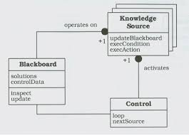
Blackboard Subsystem Decomposition
A blackboard-system consists of three major components
  The blackboard. A shared repository of problems, partial solutions and new information.
  The knowledge sources (KSs). Each knowledge source embodies specific expertise. It reads the information placed on the blackboard and places new information on the blackboard.
  The control shell. It controls the flow of problem-solving activity in the system, in particular how the knowledge sources get notified of new information put into the blackboard.
Notes:
From http://en.wikipedia.org/wiki/Blackboard_(computing):
Ad 1: Like the human experts at a blackboard, each knowledge source provides specific expertise needed by the application. The ability to support interaction and cooperation among diverse KSs creates enormous flexibility in designing and maintaining applications.
Ad 2: The blackboard can be thought of as a dynamic "library" of contributions to the current problem that have been recently "published" by other knowledge sources.
Ad 3: Just as the eager human specialists need a moderator to prevent them from trampling in a mad dash to grab the chalk, KSs need a mechanism to organize their use in the most effective and coherent fashion. In a blackboard system, this is provided by the control shell.

Slide 39
Repository Architecture Example: Incremental Development Environment (IDE)
Compiler
SemanticAnalyzer
SyntacticAnalyzer
Optimizer
Parse
Tree
Symbol
Table
LexicalAnalyzer
CodeGenerator
Repository
ParseTree
SymbolTable
SyntacticEditor
SymbolicDebugger
Notes:
This is the architecture of modern interactive programming environments such as Eclipse: The compiler consists of several subsystems, such as syntactic analysis, semantic analsys, each of these subsystems read and write into the repository subsystems Parsetree and symboltable.
The symbol table can then be accessed by a symbolic debugger at runtime.
Hearsay II speech understanding system (“Blackboard architecture”)
Database Management Systems
Modern Development Environments (Eclipse, …)

Slide 40
Providing Consistent Views
Problem: In systems with high coupling changes to the user interface (boundary objects) often force changes to the entity objects (data)
  The user interface cannot be reimplemented without changing the representation of the entity objects
  The entity objects cannot be reorganized without changing the user interface
Solution: Decoupling! The model-view-controller architectural style decouples data access (entity objects) and data presentation (boundary objects)
    The Data Presentation subsystem is called the View
    The Data Access subsystem is called the Model
    The Controller subsystem mediates between View (data presentation) and Model (data access)
Often called MVC.

Slide 41
Model-View-Controller Architectural Style
Subsystems are classified into 3 different types
  Model subsystem: Responsible for application domain knowledge
  View subsystem: Responsible for displaying application domain objects to the user
  Controller subsystem: Responsible for sequence of interactions with the user and notifying views of changes in the model
Class Diagram
initiator
Controller
1
repository
*
Model
1
notifier
subscriber
View
*
Better understanding with a Collaboration Diagram
Notes:
The MVC style is a special case of the repository architectural style:
Model subsystem implements the Repository, the Controller subsystem explicitly dictates the control flow
Example: Filesystem based on MVC

Slide 42
UML Collaboration Diagram
A Collaboration Diagram is an instance diagram that visualizes the interactions between objects as a flow of messages. Messages can be events or calls to operations
Communication diagrams describe the static structure as well as the dynamic behavior of a system:
  The static structure is obtained from the UML class diagram
    Collaboration diagrams reuse the layout of classes and associations in the class diagram
  The dynamic behavior is obtained from the dynamic model (UML sequence diagrams and UML statechart diagrams)
    Messages between objects are labeled with a chronological number and placed near the link the message is sent over
Reading a collaboration diagram involves starting at message 1.0, and following the messages from object to object.

Slide 43
Example: Modeling the
Sequence of Events in MVC
UML Class Diagram
Controller
initiator
*
1
repository
Model
1
notifier
View
subscriber
*
4.0 User types new filename
:Controller
5.0 Request name change in model
1.0 Subscribe
:Model
7.0 Show updated views
6.0 Notify subscribers
:InfoView
3.0Subscribe
:FolderView
2.0Subscribe
:PowerpointView
UML Collaboration Diagram

Slide 44
3-Layer-Architectural Style
3-Tier Architecture
Definition: 3-Layer Architectural Style
  An architectural style, where an application consists of 3 hierarchically ordered subsystems
    A user interface, middleware and a database system
    The middleware subsystem services data requests between the user interface and the database subsystem
Definition: 3-Tier Architecture
  A software architecture where the 3 layers are allocated on 3 separate hardware nodes
Note: Layer is a type (e.g. class, subsystem) and Tier is an instance (e.g. object, hardware node)
Layer and Tier are often used interchangeably.

Slide 45
Example of a 3-Layer Architectural Style
Three-Layer architectural style are often used for the development of Websites:
  1. The Web Browser implements the user interface
  2. The Web Server serves requests from the web browser
  3. The Database manages and provides access to the persistent data.

Slide 46
Example of a 4-Layer Architectural Style
4-Layer-architectural styles (4-Tier Architectures) are usually used for the development of electronic commerce sites. The layers are
  The Web Browser, providing the user interface
  A Web Server, serving static HTML requests
  An Application Server, providing session management (for example the contents of an electronic shopping cart) and processing of dynamic HTML requests
  A back end Database, that manages and provides access to the persistent data
    In current 4-tier architectures, this is usually a relational Database management system (RDBMS).

Slide 47
MVC vs. 3-Tier Architectural Style
The MVC architectural style is nonhierarchical (triangular):
    View subsystem sends updates to the Controller subsystem
    Controller subsystem updates the Model subsystem
    View subsystem is updated directly from the Model subsystem
The 3-tier architectural style is hierarchical (linear):
    The presentation layer never communicates directly with the data layer (opaque architecture)
    All communication must pass through the middleware layer
History:
  MVC (1970-1980): Originated during the development of modular graphical applications for a single graphical workstation at Xerox Parc
  3-Tier (1990s): Originated with the appearance of Web applications, where the client, middleware and data layers ran on physically separate platforms.

Slide 48
Pipes and Filters
A pipeline consists of a chain of processing elements (processes, threads, etc.), arranged so that the output of one element is the input to the next element
  Usually some amount of buffering is provided between consecutive elements
  The information that flows in these pipelines is often a stream of records, bytes or bits.

Slide 49
Pipes and Filters Architectural Style
An architectural style that consists of two subsystems called pipes and filters
  Filter: A subsystem that does a processing step
  Pipe: A Pipe is a connection between two processing steps
Each filter has an input pipe and an output pipe.
  The data from the input pipe are processed by the filter and then moved to the output pipe
Example of a Pipes-and-Filters architecture: Unix
  Unix shell command: ls -a l cat
A pipe
The Unix shell commands ls
and cat are Filter

Slide 50
System Design Activities: From Objects to Subsystems
CASE STUDY

Slide 51
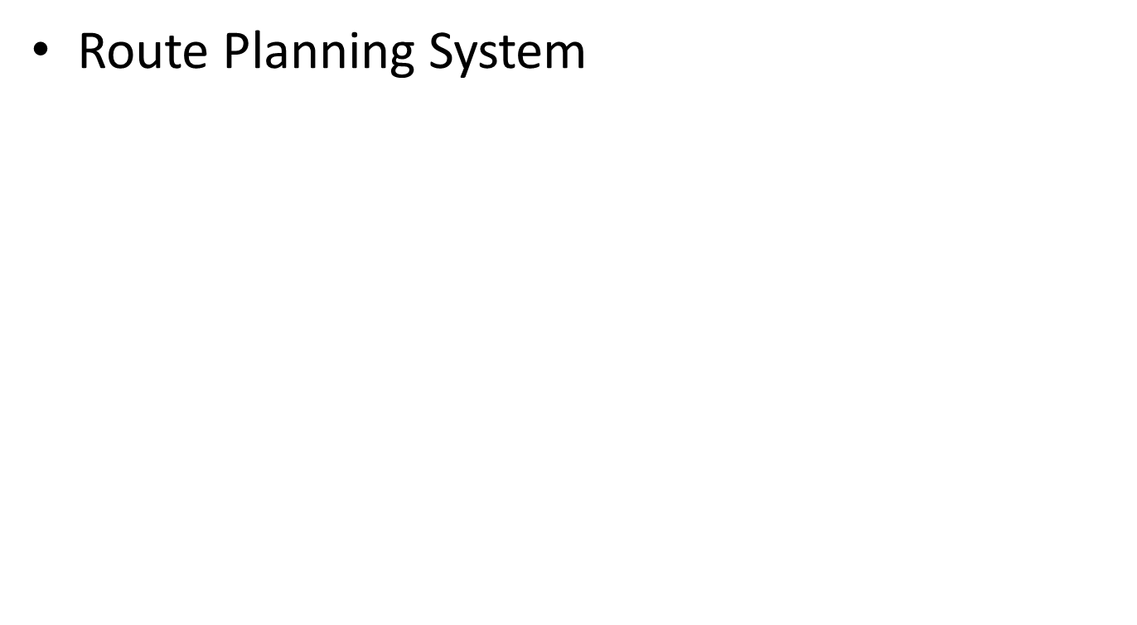


Slide 52
1.Starting Point: Analysis Model for a Route Planning System
MyTrip, a route planning system for car drivers
Using MyTrip, a driver can plan a trip from a home computer by contacting a trip-planning service on the Web (PlanTrip in Figure). The trip is saved for later retrieval on the server.
The trip-planning service must support more than one driver.

Slide 53
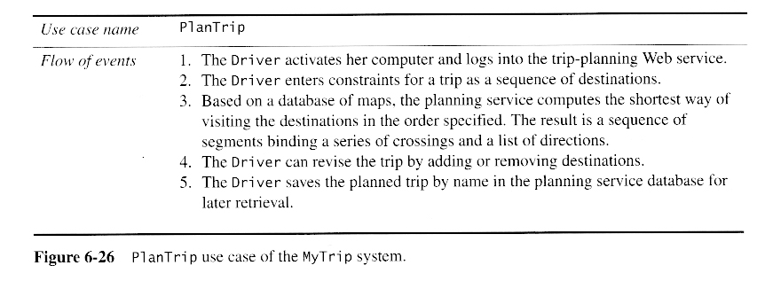

Slide 54
The driver then goes to the car and starts the trip, while the onboard computer gives
directions based on trip information from the planning service and her current position indicated by an onboard GPS system (ExecuteTrip in Figure ).

Slide 55
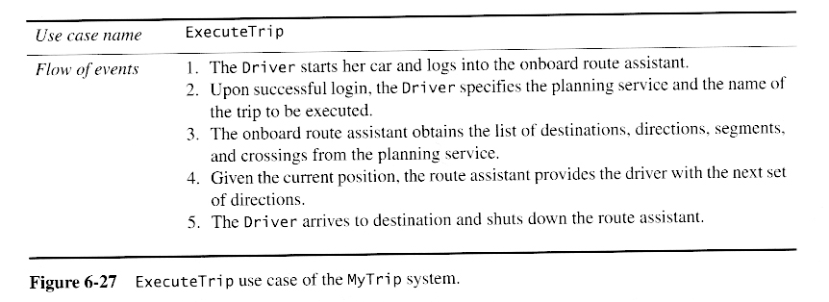

Slide 56
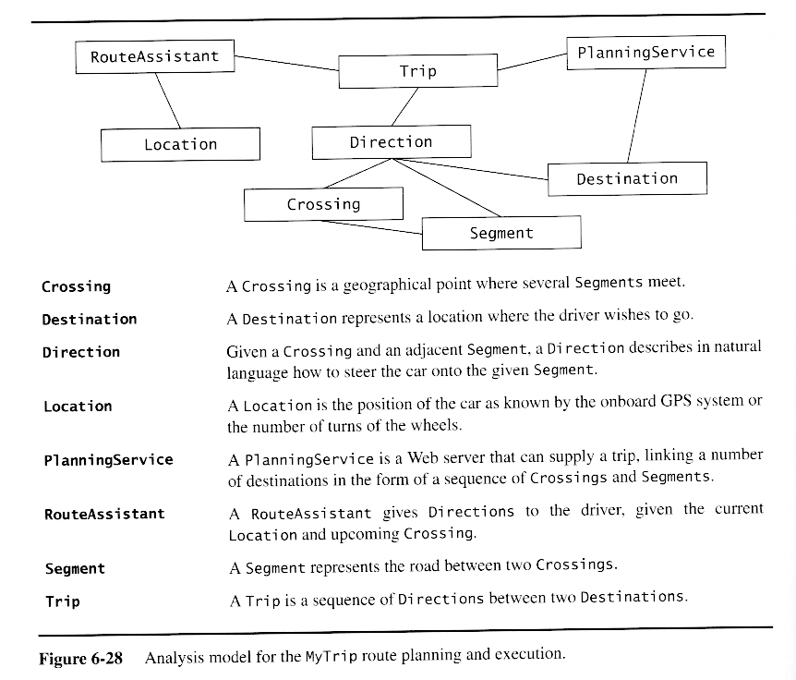
Analysis Model

Slide 57
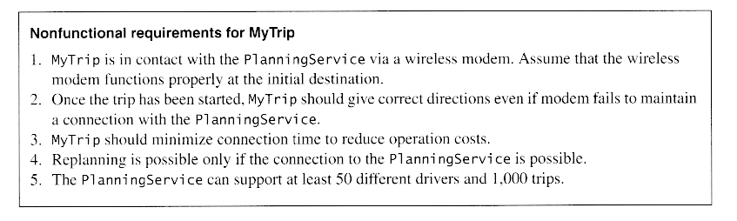

Slide 58
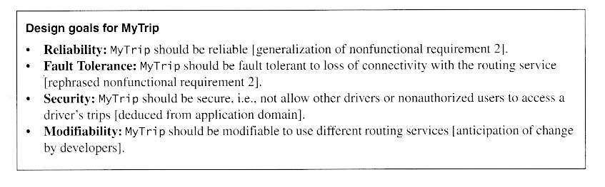
2.Identifying Design Goals

Slide 59
The design Criteria is grouped as performance, dependability, cost , maintenance and end user criteria.

Slide 60
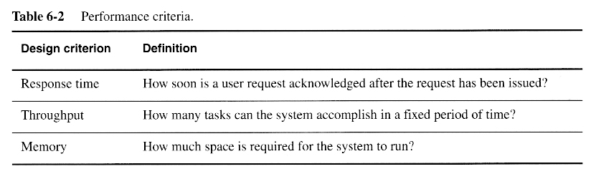

Slide 61
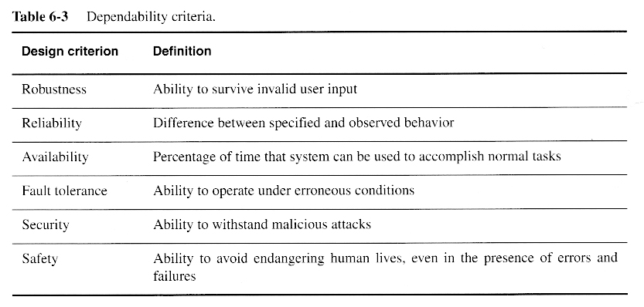

Slide 62
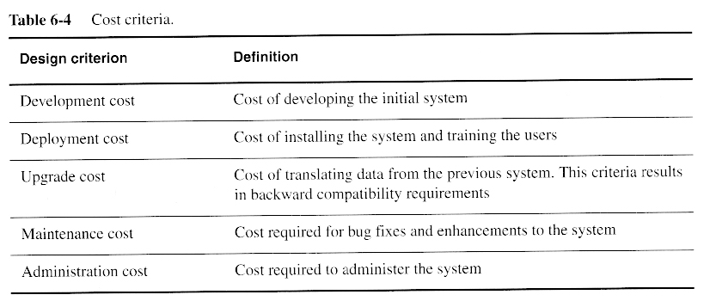

Slide 63
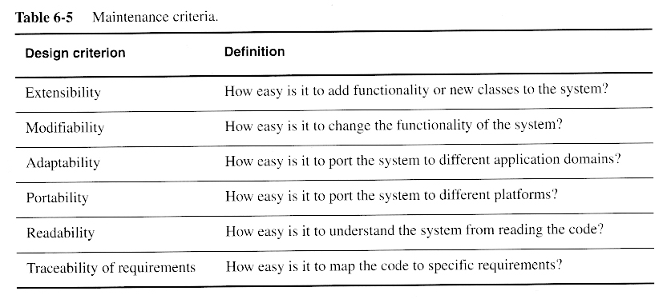

Slide 64
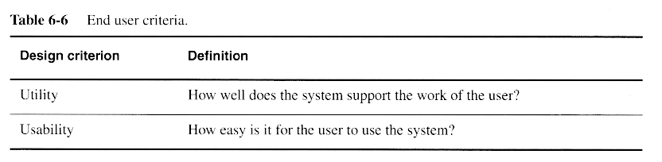

Slide 65
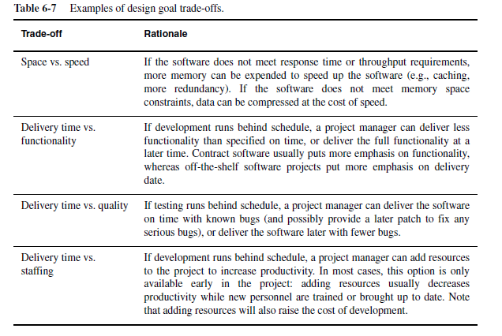
Design goal Trade -offs

Slide 66
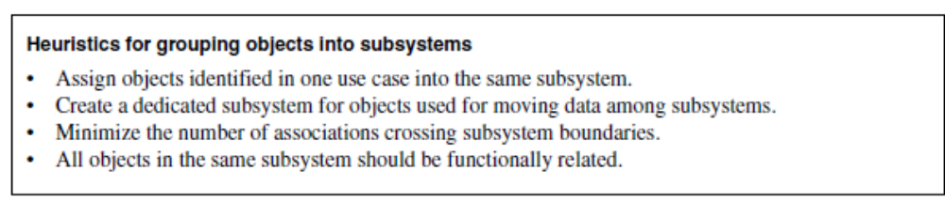
3. Identifying Subsystems

Slide 67
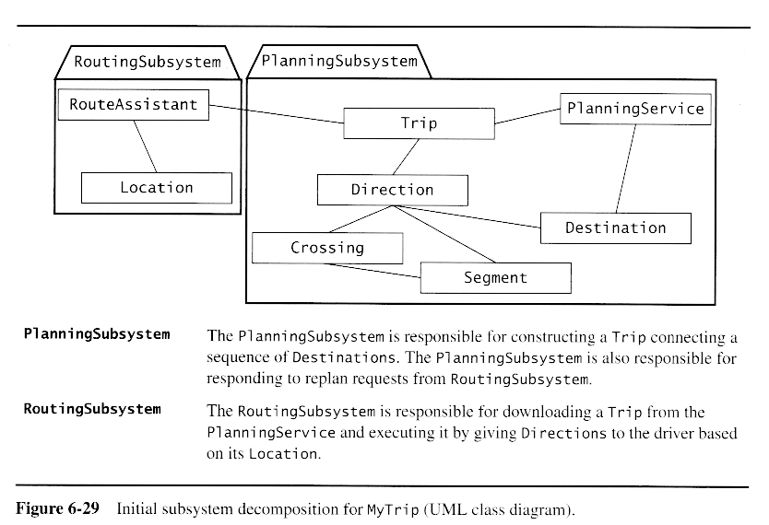

Slide 68
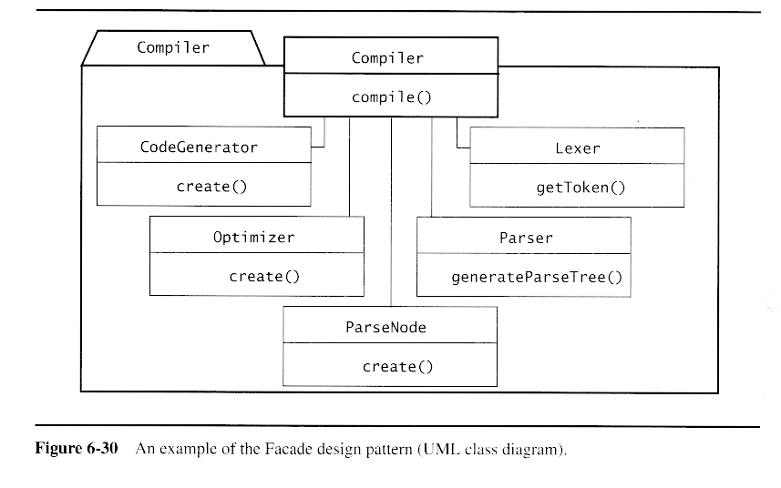
Encapsulating subsystems with the Facade design pattern

Slide 69
Summary
System Design
  An activity that reduces the gap between the problem and an existing (virtual) machine
Design Goals Definition
  Describes the important system qualities
  Defines the values against which options are evaluated
Subsystem Decomposition
  Decomposes the overall system into manageable parts by using the principles of cohesion and coherence
Architectural Style
  A pattern of a typical subsystem decomposition
Software architecture
  An instance of an architectural style
  Client Server, Peer-to-Peer, Model-View-Controller.

